Slide 1
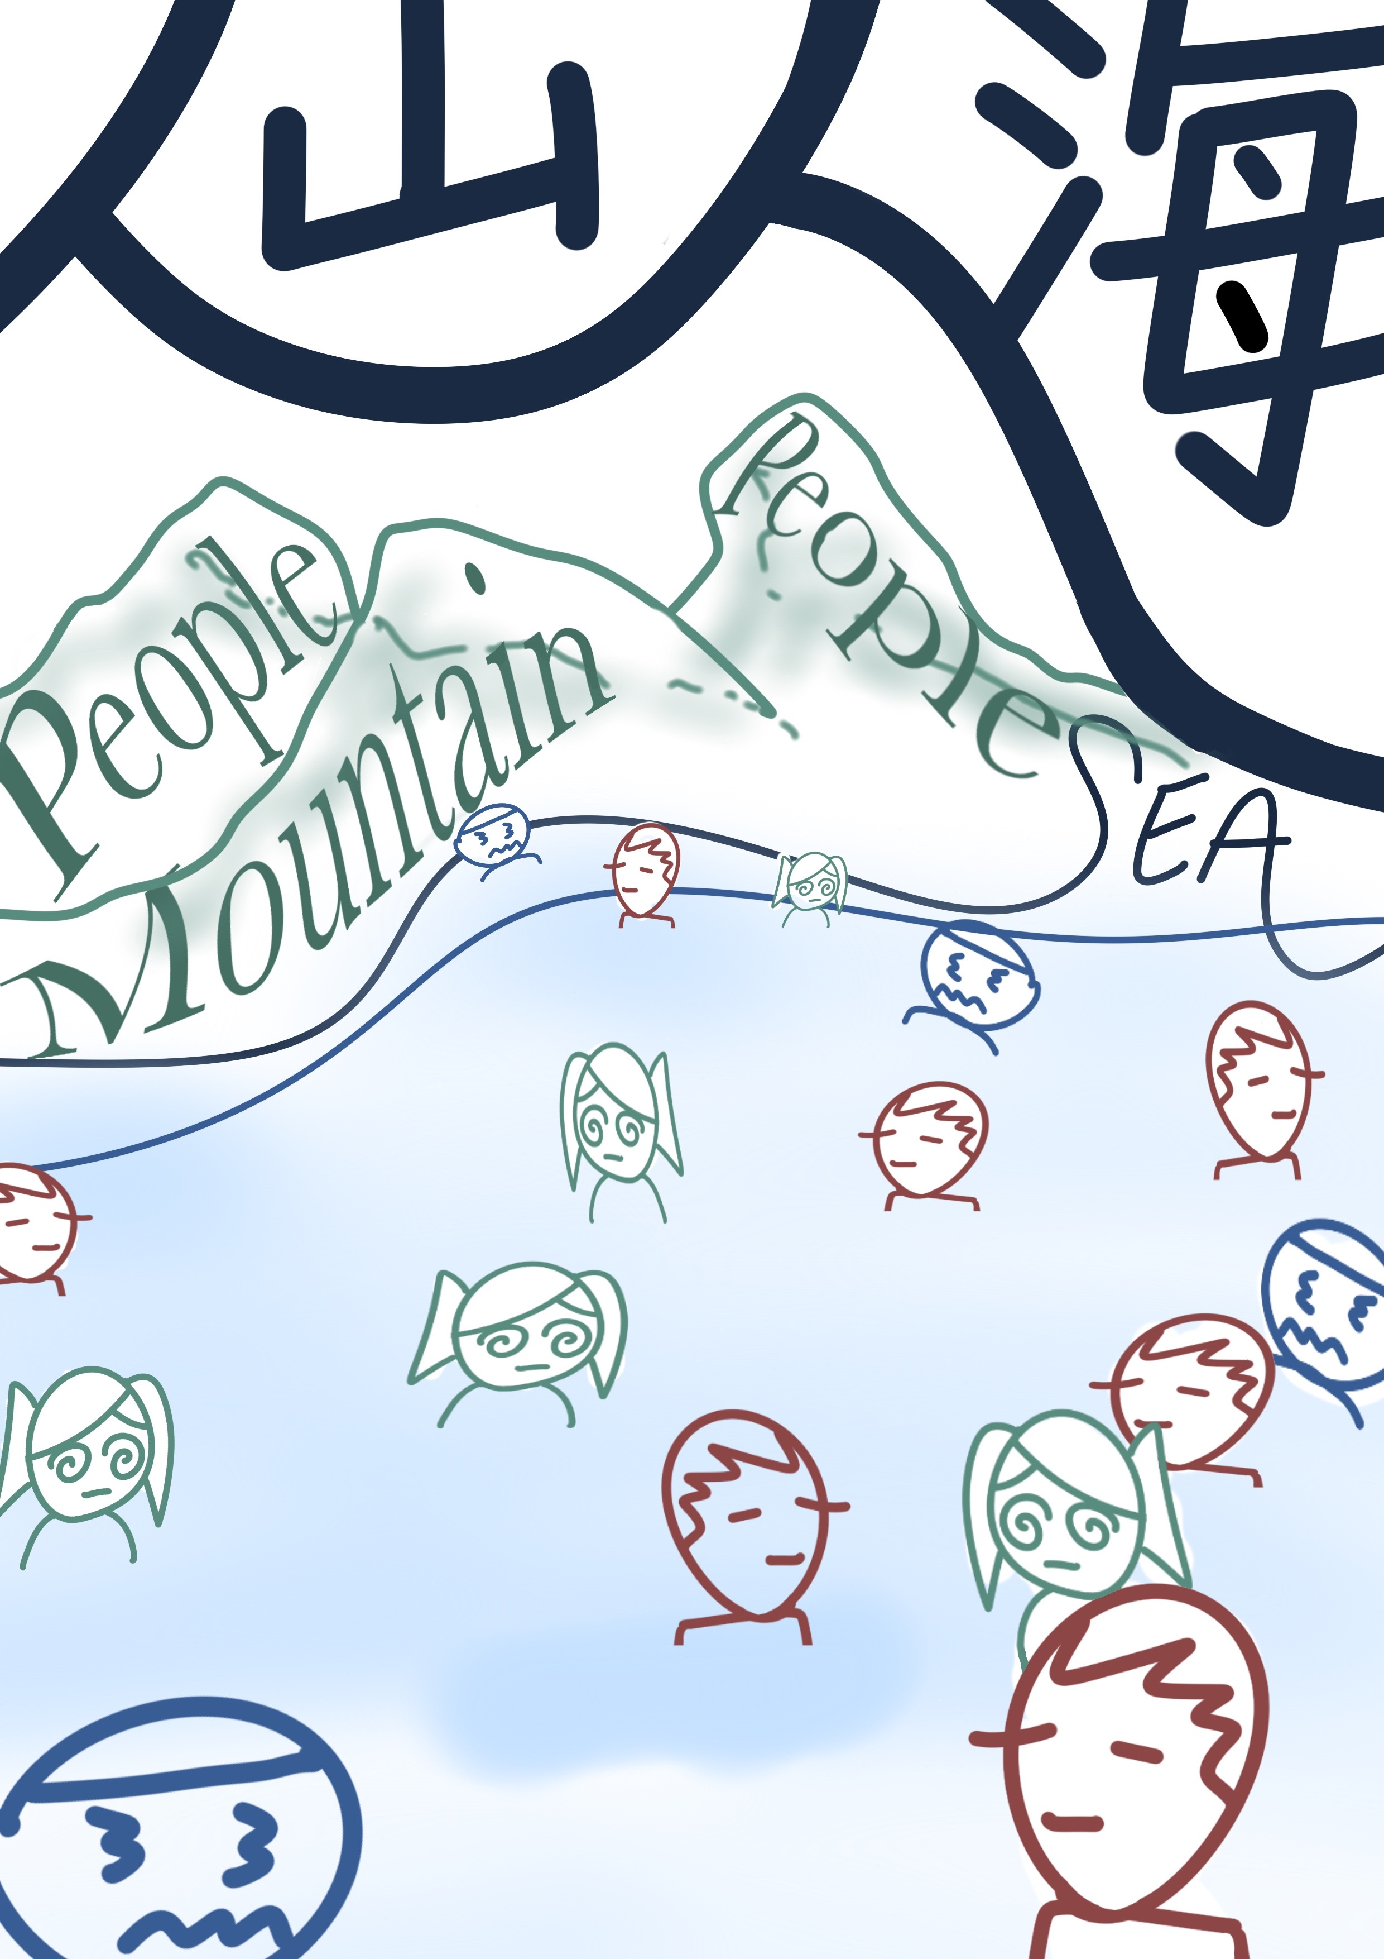
Language-Art Project: a curatorial collaboration
Karen Harris
Intercultural Communications Trainer/
Language Development Tutor
Language Centre
University of the Arts London
k.harris@arts.ac.uk

Slide 2
Background notes to LAP
Founded 2019.
Bringing students together from across UAL, to:
discuss/ reflect on language
create language-themed art (solo/ collaborative)
Online (+ physical) exhibition
https://www.arts.ac.uk/study-at-ual/language-centre/language-art-project

Slide 3
Focus of today’s talk:
The staff/ student curatorial partnership
Our curatorial team:
Hal Warren: BA CCC (Yr 2) @ CSM
Jasmine Rawlinson: BA CCC (Yr 2) @ CSM
Haoyue Chen: MA Curating & Collections @ Chelsea

Slide 4
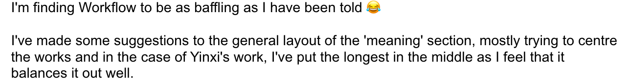
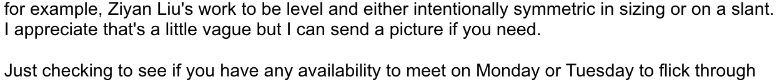
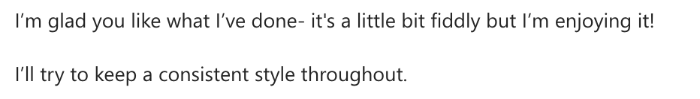
How it started…
2022 online gallery: first offer of curatorial help
My initial hesitancy … and subsequent gratitude!

Slide 5
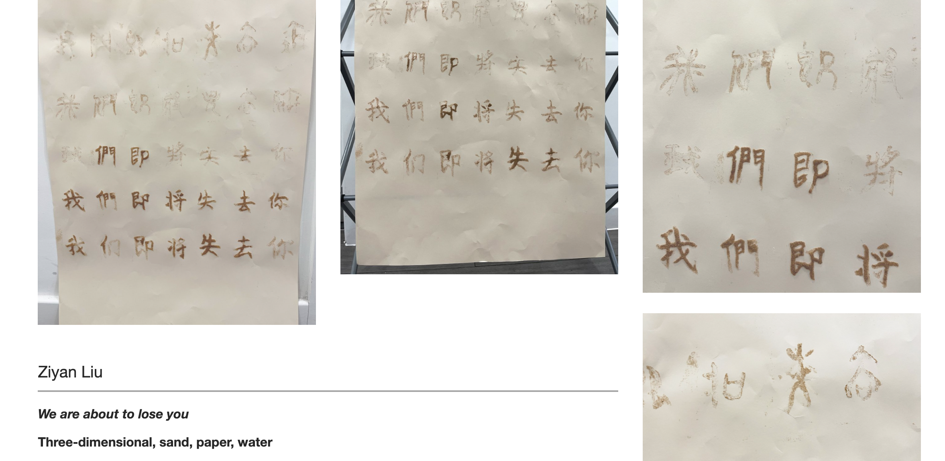
Hal’s calm, tenacious work -and great communication- resulted in some excellent changes to my formatting attempts!

Slide 6
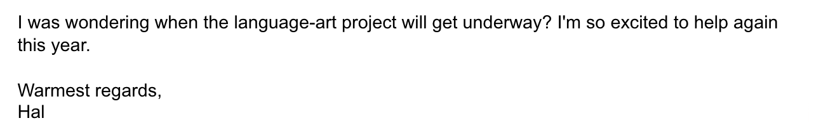
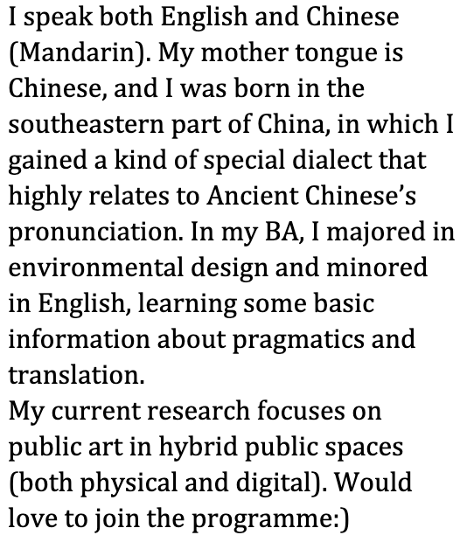
And in 2023…

Slide 7
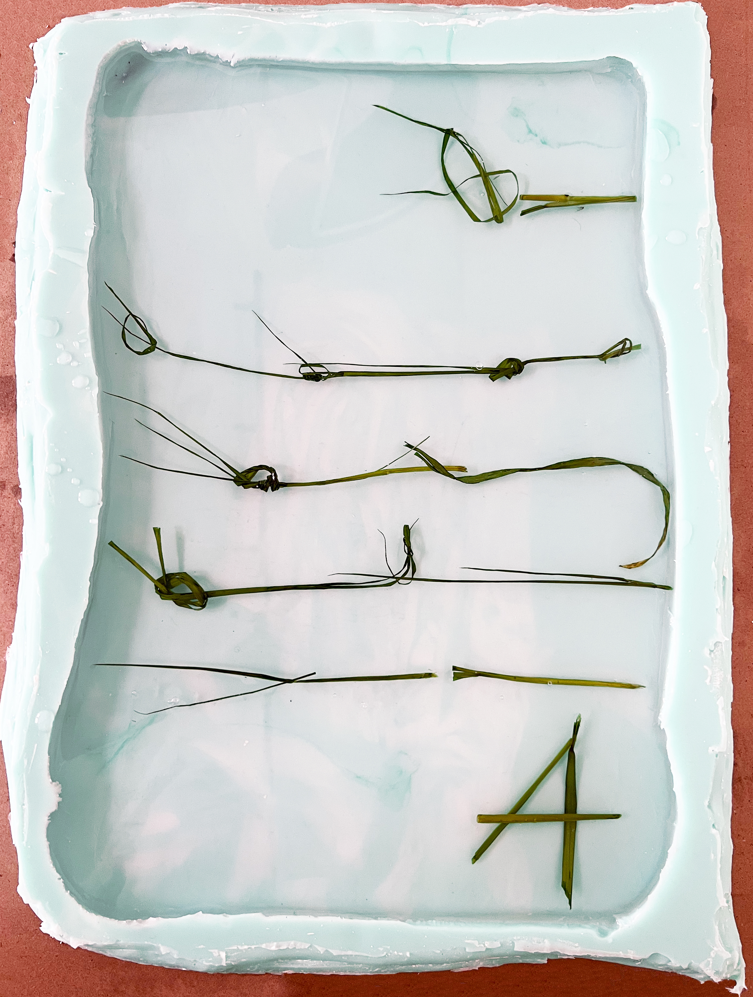
2023 was different because:
Physical (as well as online) exhibition.
So … loads more work!!
Online: MyBlog (for gallery pages)
Physical: SU Gallery Space @ LCC

Slide 8
Online exhibition: division of labour
Me:
Gathering, checking, categorising submissions
Building gallery pages (MyBlog)
Liaising with Digital Comms re. home page
Curation team:
Advisory role (re. formatting, aesthetics…)
Creation of curatorial text
Behind-the-scenes info/idea-gathering missions…

Slide 9
Physical gallery: division of labour
SO many considerations!
Curation team took on the responsibility for:
gallery plan and visitor handout (design)
contacting specific artists where necessary
formatting and printing of descriptive labels
working with technician to install exhibition

Slide 10
Physical gallery: division of labour (continued)
My responsibilities:
overall project management (executive control)
logistics (booking technician; Darkroom Bar)
liaising with LCC Events/ Reception/ others
general admin (inc. risk assessments)
comms + promo/ publicity (inc. EventBrite)
firefighting!

Slide 11
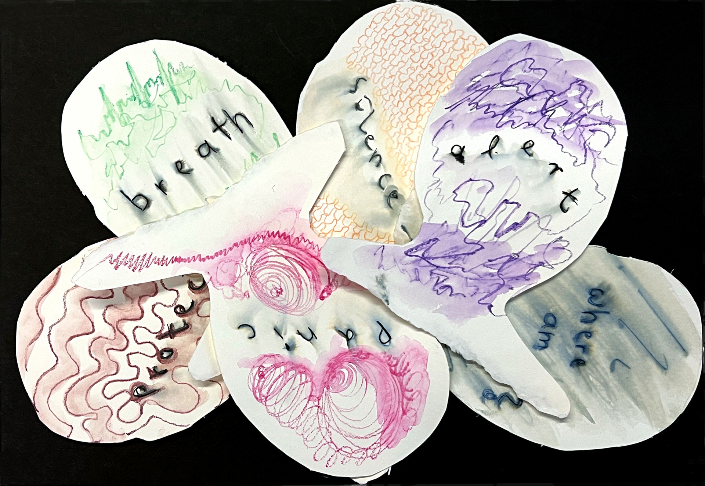
Disagreements within the team…?
Inevitably!
Group dynamics, diplomacy and mediation…

Slide 12
Complementary skills
Curation team:
Positivity and enthusiasm
Can-do attitude: keen to take on a variety of roles
Subject knowledge (curation)
Me:
Anticipating logistical considerations and snags
Realistic sense of what’s doable in timeframe
Useful cynicism based on years of experience!

Slide 13
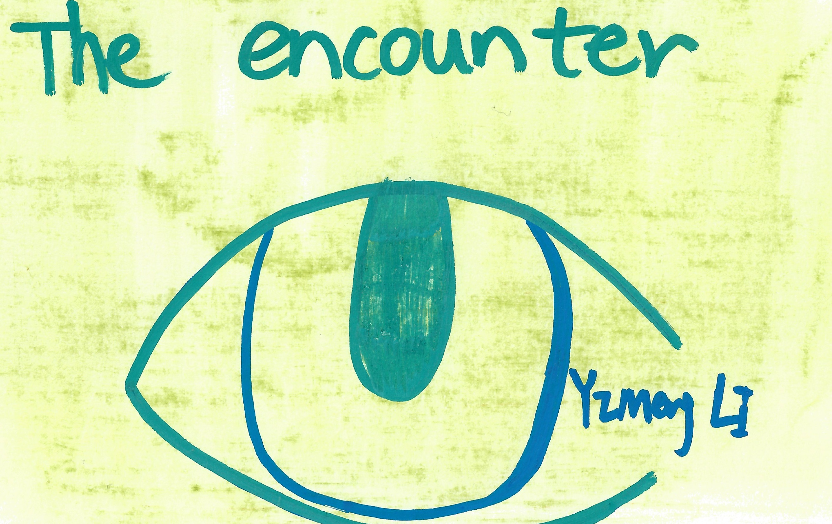
My reflective take-away
Eroding the staff-student barrier…
…Vulnerability

Slide 14
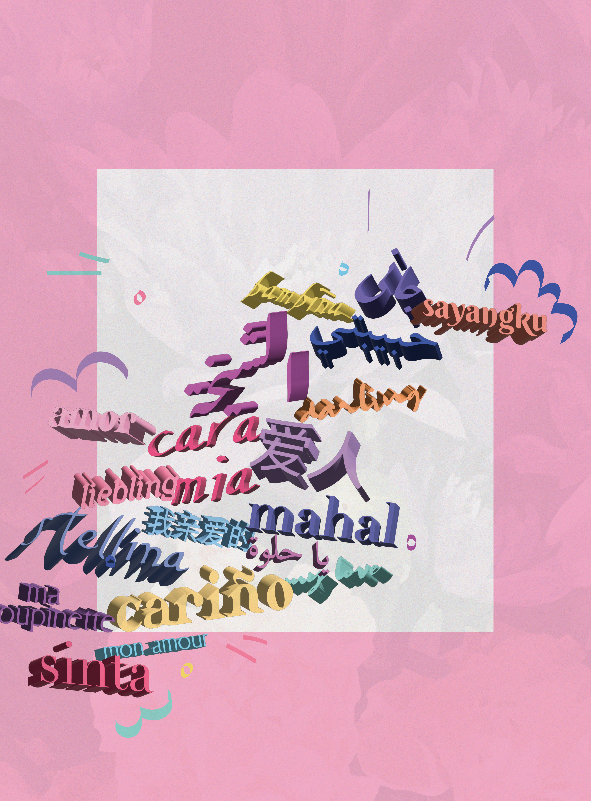
Thoughts from the team
I feel incredibly grateful for the opportunity (…) Throughout this journey, we encountered new knowledge, navigated site-specific challenges, and fostered fruitful collaborations. It has been an unforgettable experience, and I'm eagerly anticipating the future progress of this fascinating project.
Haoyue Chen

Slide 15
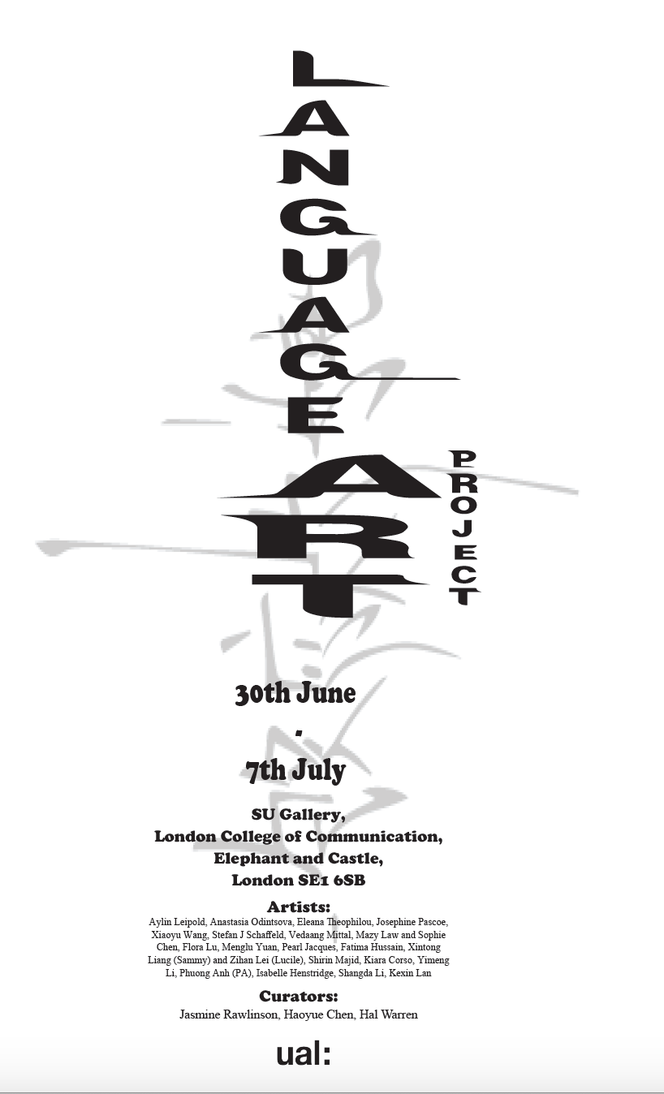
Notes on payment
We pay our student partners via ArtsTemps.
When running projects with students:
What is paid?
What is not paid?
And how do we make the distinction?

Slide 16
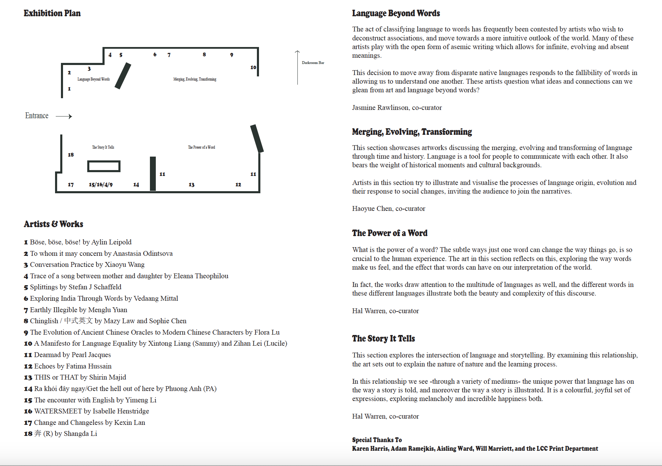
Finally… come see our exhibition!
SU Gallery Space (outside the Darkroom Bar)
LCC (London College of Communication,Elephant and Castle, London SE1 6SB
Until 7th July 2023

Slide 17
Thank you!
Unless otherwise stated, all images are from the 2023 Language-Art Project.
Slide 1: Chinglish by Mazy Law and Sophie Chen
Slide 5: We are about to lose you by Ziyan Liu (from 2022 Language-Art Project)
Slide 7: To whom it may concern by Anastasia Odintsova
Slide 11: Splittings by Stefan J Schaffeld
Slide 13: The encounter with English by Yimeng Li
Slide 14: Adoration (from the Echoes series) by Fatima Hussain
Slides 15-16: Visitor handout by Haoyue Chen, Jasmine Rawlinson and Hal Warren
To learn more about these works, along with many others, please visit https://www.arts.ac.uk/study-at-ual/language-centre/language-art-project

